Slide 1

Master thesis October meeting
Jesse Keränen
27.10.2023

Slide 2
Progress during October
Due to technical difficulties data collection can only begin at the beginning of next month
  Participated in the Datastream training
Have been reading related literature
  Lot of literature available for US and Europe, struggling to find good sources for Nordic studies
  Results from previous literature confirmed initial selecetion of the methodology
  Literature review almost ready and set of explanatory variables derived from it

Slide 3
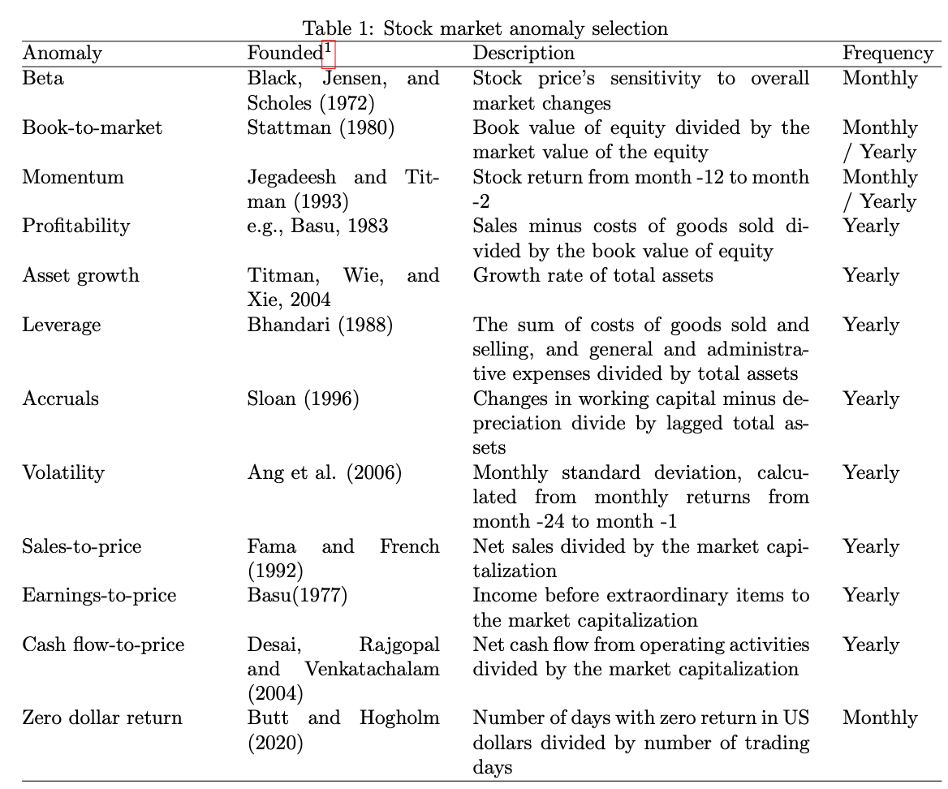
Refined research question
Fama-French factors
Factors shown profitability in Nordics
  Value
  Momentum
  Cash-flow
  Liquidity
Should alternative varitions of same factors be included

Slide 4
Next steps
Suggestions for literature I might have missed?
How to register to the seminars?
Would it be possible to have a separate meeting for data collection once my account has been re-activated?
  I will collect the Worldscope codes for the variables needed to calculate my factors.

